Slide 1
GA-Net: A Genetic Algorithm for Community detection in social Networks Clara Pizzuti
Karolina Sabonaityte
Brandy Barber

Slide 2
Introduction
Purpose: Use a Genetic Algorithm to detect clusters within communities to gain insights about communities in social networks
A Social Network (SN) is a collection of people with connections, such as:
Common interests
Friendship
Religion

Slide 3
Introduction
Community Structure
Community Score
Contains clusters of people who share similar interests
Connection
Score obtained by the Genetic Algorithm used to quantify the strength of the relationship between connections in a community
Goal is to obtain high intra-connections and low inter-connections

Slide 4
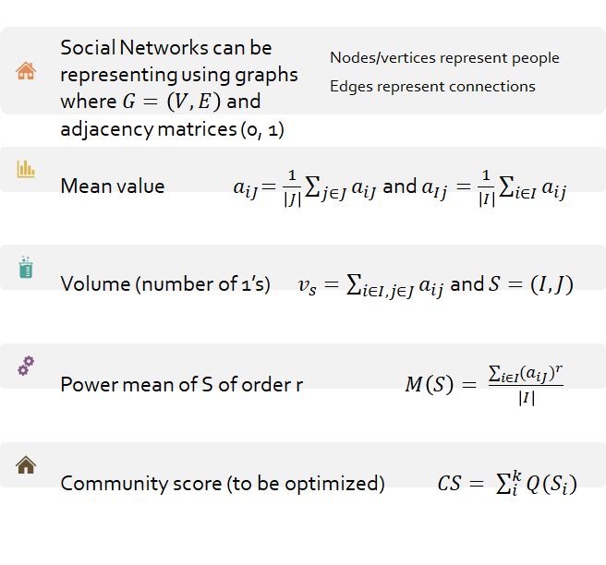
Problem Definition

Slide 5
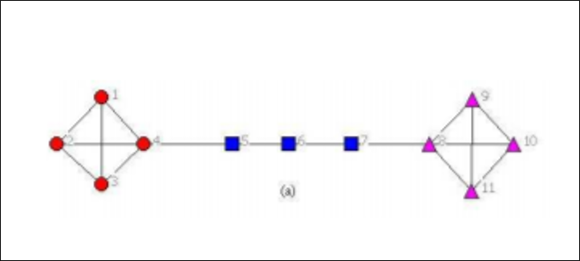
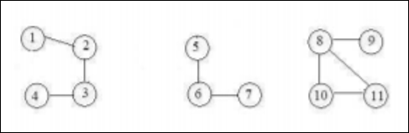
GA-Net Algorithm
Representation
Locus-based adjacency
Position: 1 2 3 4 5 6 7 8 9 10 11
Genotype:
Initialization
The concept of a safe individual is used when randomly generating values for an individual and involves repairing individuals with no connections. This involves taking a neighbor in i and substituting a j value
2 | 1 | 2 | 3 | 6 | 5 | 6 | 10 | 8 | 11 | 8

Slide 6
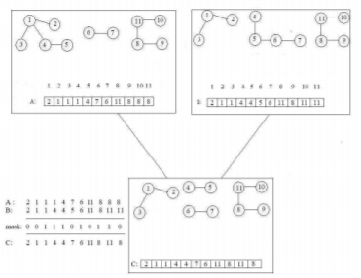
GA-Net Algorithm
Crossover
Mutation
Uniform Crossover maintains the relationship of children
Repaired Mutation similar to the repaired initialization ensures that the possible value also exists in a neighbor

Slide 7
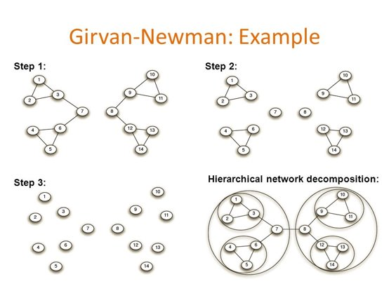
Girvan and Newman
Removal of edges from the network using betweenness measures

Slide 8
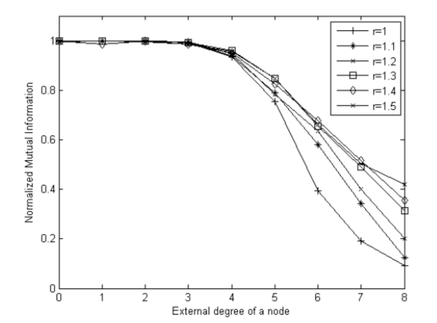
Synthetic Experiment
Crossover rate: 0.8
Mutation rate: 0.2
Elite reproduction 10% of the population size
Roulette selection function
Population size: 300
Number of generations: 30
Synthetic data set proposed by Girvan and Newman:
Network consists of 128 nodes divided into four communities of 32 nodes each

Slide 9
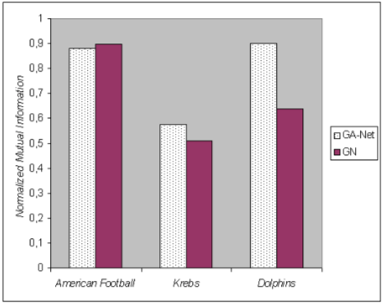
Real-World Experiments
American College Football
Network: schedule of Division I games during 2000 season
Nodes: teams
Edges: season games between two teams
Krebs' books on American politics
Nodes: recent books on American politics
Edges: join pairs of books from same buyer
Divided according to political alignment
Bottlenose Dolphins
Nodes: dolphins
Edges: behavior and associations
Naturally split into two large groups

Slide 10
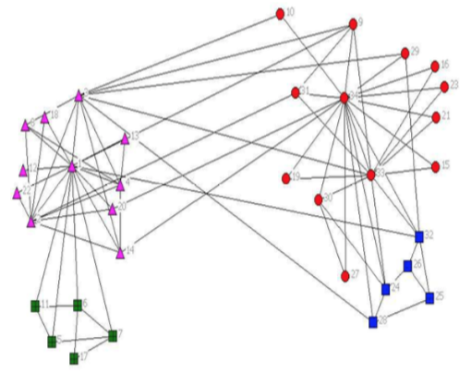
Zackary's Karate Club Study
Friendship associations of 34 members of a karate club

